Slide 1
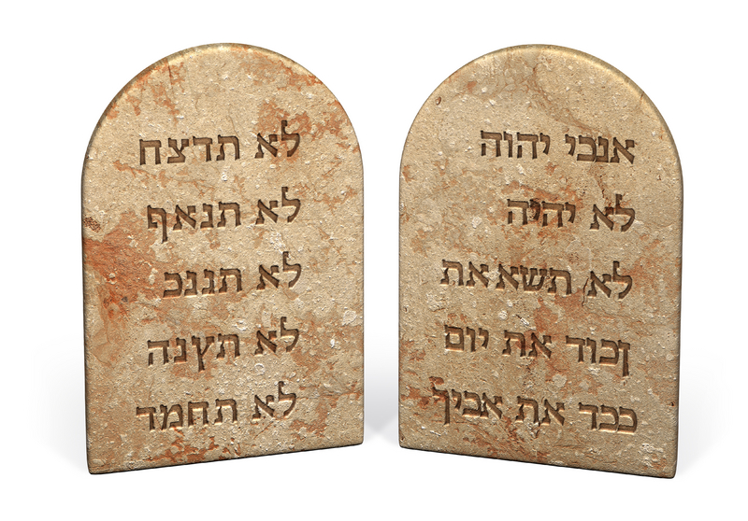
TEN Commandments
Exodus 20:1-17

Slide 2
Overview

Slide 3
Overview
In CONTENT, the Decalogue is authoritative as any other biblical law.
In FORM, however, the Decalogue does not resemble typical laws.
❶ TOO brief
❷ NO punishment specified
REASONS

Slide 4
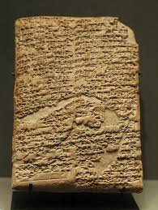
Overview
Comparison to Hammurabi’s Code
The Old Testament Law is superior because:
Old Testament Law placed a higher value on life than
property.
Old Testament Law tempered gross punishments.
“eye for eye, tooth for tooth, hand for hand, foot for foot, burn for burn, wound for wound, bruise for bruise” (EX. 21:24-25)
❸ Old Testament Law rejected class distinctions.
❹ Old Testament Law expressed greater concern for the privileges of slaves and encouraged humane treatment.
JUSTICE
Equal Protection Under the Law

Slide 5
Analysis
You shall have no other gods before me. (Exodus 20:3)
“Not it will be for you other gods above my face”
answers the question, “WHOM do we worship?”
Catholics treat Exodus 20:3-6 as ONE command.
God should be the ONLY direct object of the verb “to worship.”

Slide 6
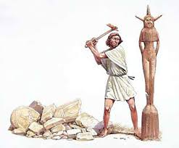
Analysis
You shall have not make for yourself an idol. (Exodus 20:4)
The second commandment answers a DIFFERENT question, therefore a follow-up to the first commandment: How do we worship God?
We worship Him directly (SEE Dt. 4:15-19)
NO IDOLS

Slide 7
Analysis

Slide 8
Analysis

Slide 9
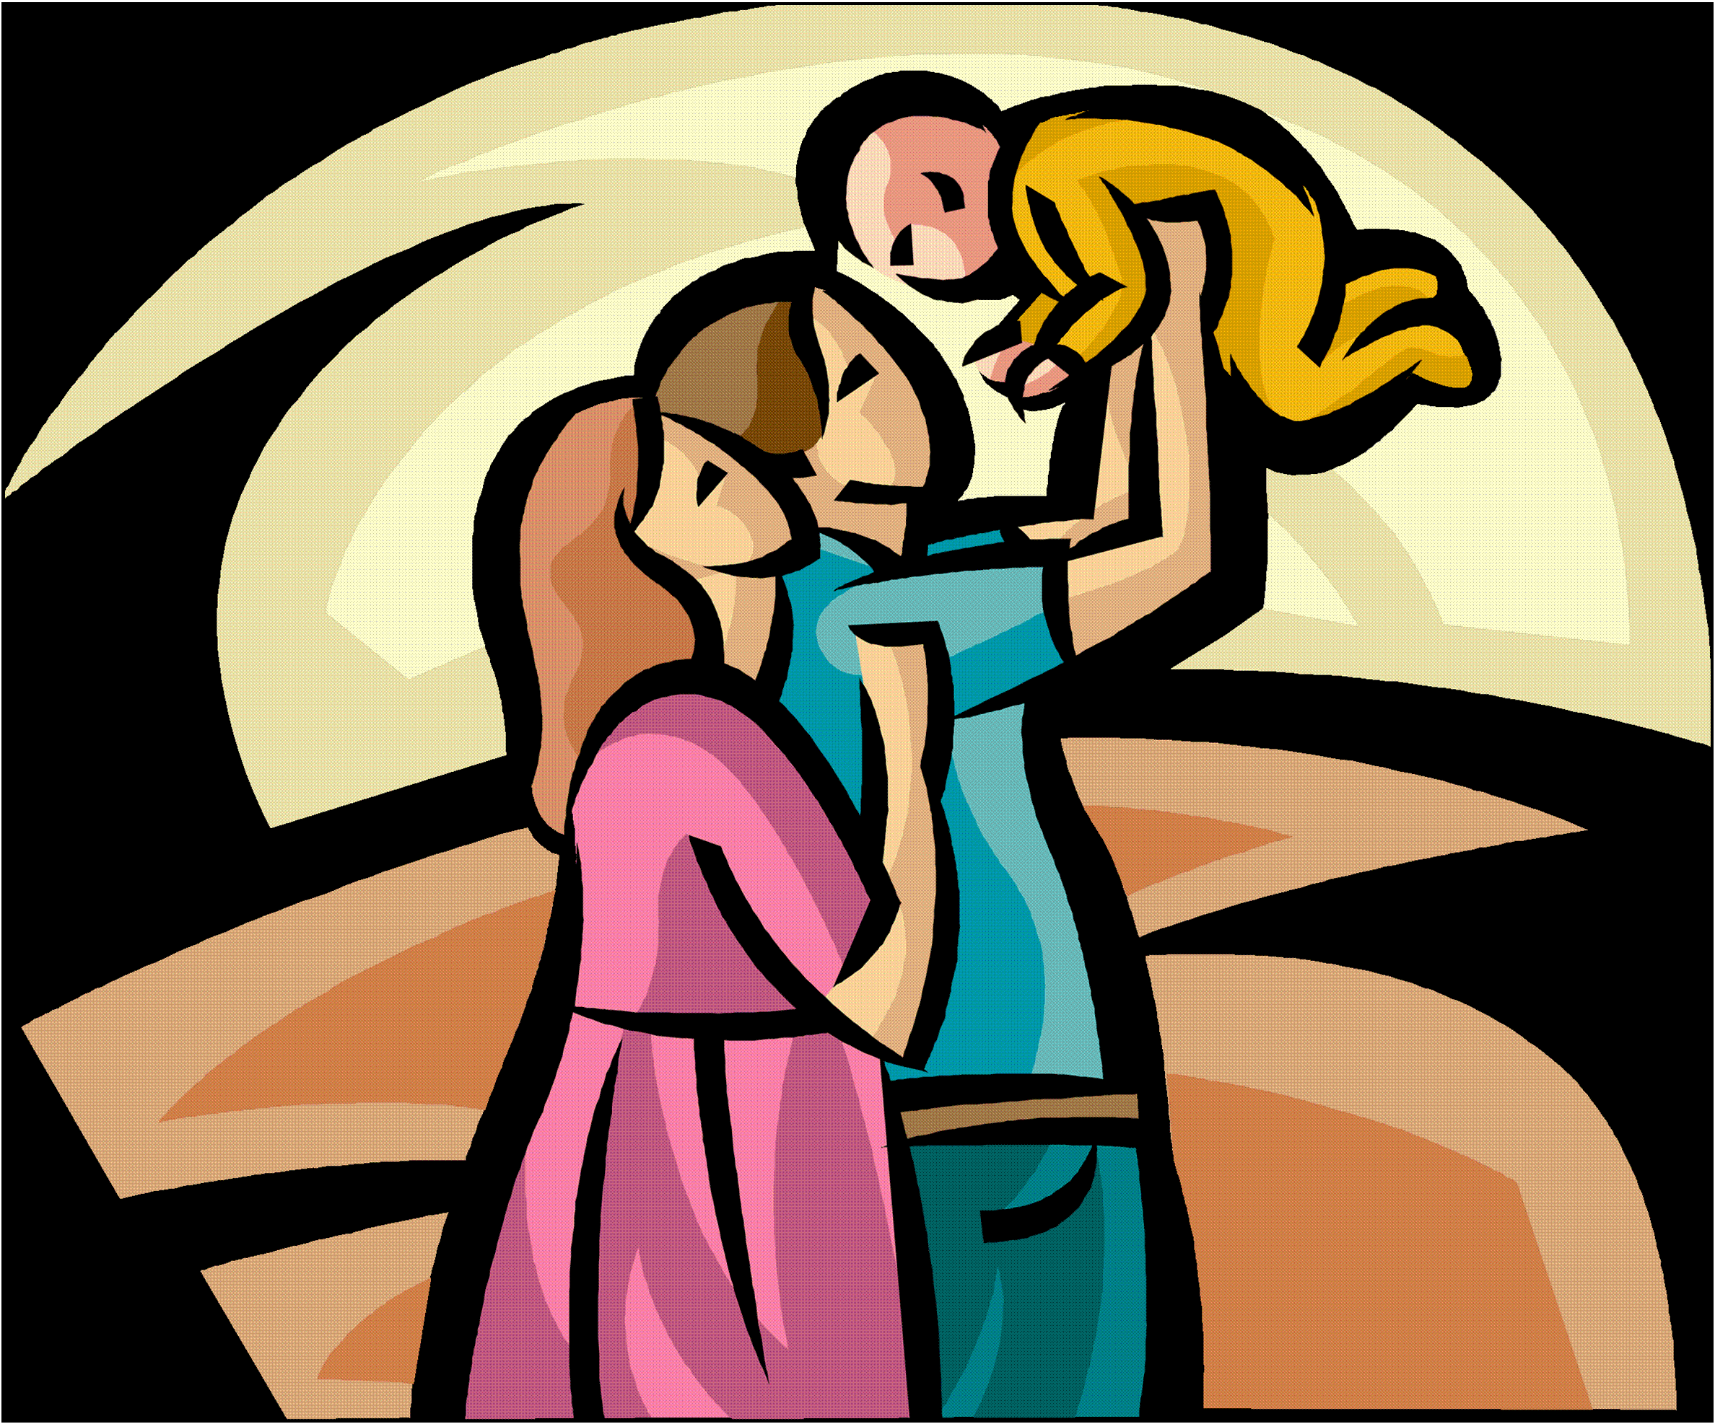
Analysis
Honor your father and your mother. (Exodus 20:12)
“the first commandment with a promise” (Eph. 6:5)
The verb “honor” represents a LIFETIME obligation.
“Obey,” on the other hand, is what a child does (See Eph. 6:1).
DEUTERONOMY 21:18-21
ROMANS 1:30

Slide 10
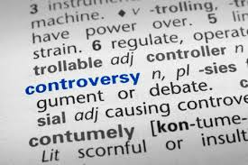
Analysis
You shall not MURDER. Thou shalt not KILL. (Exodus 20:13, NASB) (KJV)
According to the Bible . . . 1. Murder is PRE-MEDITATED (DT. 19:4-6) 2. The murder victim is INNOCENT (Prov. 6:16-18).
capital punishment euthanasia war suicide
abortion

Slide 11
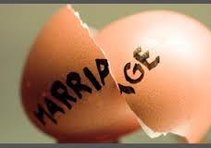
Analysis
You shall not commit adultery. (Exodus 20:14)
PRINCIPLE: Sexual Purity ☑ NO Pre-Marital Sex ☑ NO Extra-Marital Sex

Slide 12
Analysis
You shall not steal. (Exodus 20:15)
PRINCIPLE: Ownership <or> Private Property

Slide 13
Analysis
You shall not bear false witness. (Exodus 20:16)
CONTEXT: Hebrew Legal System A guilty verdict required 2-3 witnesses whose testimonies agreed (DT 17:6; 19:15).
PERJURY: To bear false witness SEE 1 Kings 21:1-14; Mark 14:53-59.
PRINCIPLE: Words have consequences. SEE Ephesians 4:15, 29.

Slide 14
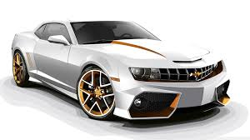
Analysis
You shall not covet. (Exodus 20:17)
Catholics divide Exodus 20:17 into TWO commands.
Covetousness is an attitude, NOT an action.
“summary commandment” [John I. Durham]

